Slide 1
Cluster Analysis with R
Michael Schilmoeller
Tuesday, November 20, 2012
R Users’ Group @ Simple

Slide 2
Overview
The NW Power and Conservation Council
Aggregation of power generation resources with cluster analysis
Identifying transmission congestion zones in the PNW
Summary of concepts

Slide 3
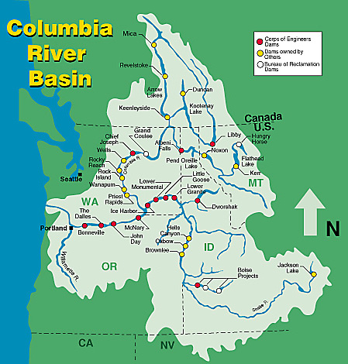
A Unique Place

Slide 4
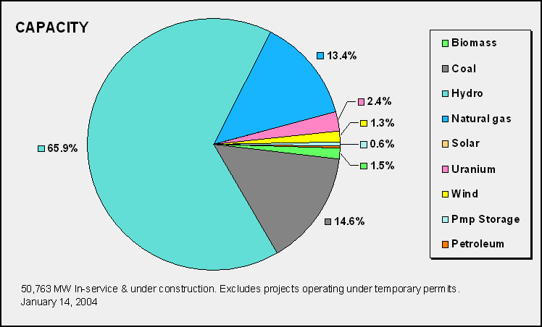

Slide 5
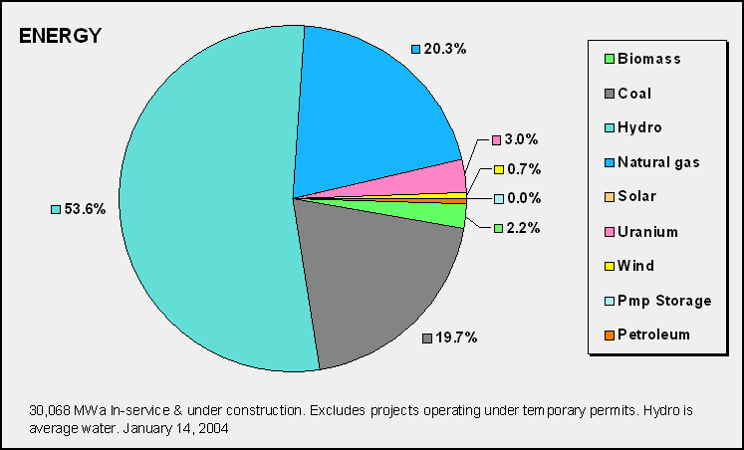

Slide 6
NWPCC: A unique agency
Created in 1980 in response to:
1. Inaccurate energy-demand forecasting
2. Problems integrating nuclear and hydropower
3. Uncertainty over future access to federal hydro
4. Failing salmon runs in the Snake and Columbia
5. Desire for more public involvement in decisions
regarding energy, and fish and wildlife

Slide 7
PNW Cumulative Savings 1978-2010

Slide 8
So What’s 4,700 average Megawatts?
It’s enough electricity to serve the entire states of Idaho and Montana
(or all of Kansas)
It saved the region’s consumers nearly than $2.5 billion in 2010
It lowered 2010 PNW carbon emissions by an estimated 18.2 million MTE.

Slide 9
Sixth Plan Resource Portfolio*
*Expected Value Build Out. Actual build out schedule depends on future conditions
slide 9
9

Slide 10
Overview
The NW Power and Conservation Council
Aggregation of power generation resources with cluster analysis
Identifying transmission congestion zones in the PNW
Summary of concepts

Slide 11
Power Generation Unit Cost of Operation
Dispatch price (p_{d}) determines whether a resources will run in a given hour
Dispatch price is the sum of variable Operations and Maintenance (VOM in $/MWh) and Fuel Costs ($)
Fuel Costs for power plants is determined by the plants efficiency or “heat rate” and the price of fuel (p_{f}) in $/BTU*10⁶
Heat rate (HR) is in BTU fuel per Watt-hour
p_{d} =VOM + p_{f}*HR (all in $/MWh)

Slide 12
Individual Units

Slide 13
Individual Units

Slide 14
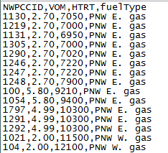
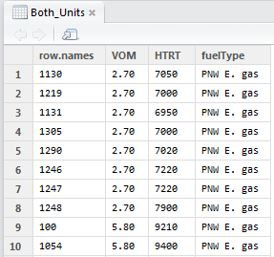
Data file and frame
Both_Units <-read.table("C:\\combined units.csv", header=TRUE, row.names = 1, sep=",")

Slide 15
Code
Both_Units <-read.table("C:\\combined units.csv", header=TRUE, row.names = 1, sep=",")
library(cluster)
agn_both <- agnes(Both_Units, metric="manhattan", stand=TRUE,diss=FALSE)
plot(agn_both)
quit()

Slide 16
Hierarchical Dendrogram
Source: C:\Backups\Plan 6\Studies\Data Development\Resources\Existing Non-Hydro\100526 Update\R Agnes cluster analysis\Cluster Analysis on units.doc
Unit Aggregation

Slide 17
Unit Aggregation
Forty-two dispatchable regional gas-fired generation units are aggregated by heat rate and variable operation cost
The following illustration assumes $4.00/MMBTU gas price for scaling
Source: C:\Backups\Plan 6\Studies\Data Development\Resources\Existing Non-Hydro\100526 Update\Cluster_Chart_100528_183006.xls
Unit Aggregation

Slide 18
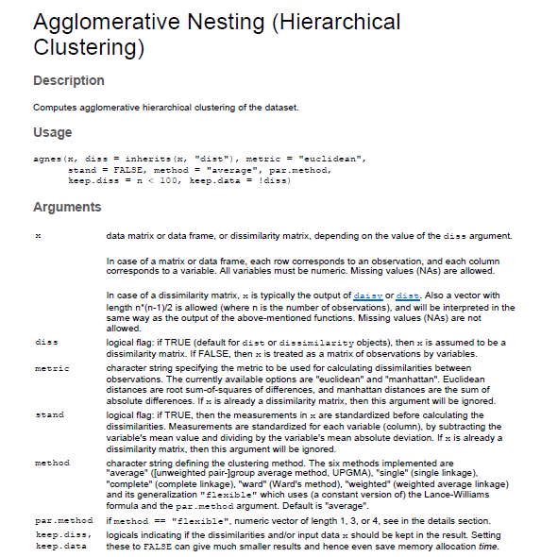
Agnes Help

Slide 19
Manhattan Metric
The Manhattan Metric refers to a the concept that the distance between points in Manhattan is determined by the number of (east-west) streets and (north-south) avenues that a taxi cab would have to drive.
Number of streets plus number of avenues
Also called the “taxi cab” metric

Slide 20
Manhattan Metric

Slide 21
Manhattan Metric
It is also the natural choice when the “distance between” two events or objects is a linear function f of parameters: d(x,y)= α₁|x₁-y₁|+ α₂|x₂-y₂|+ … + α_{k}|x_{k}-y_{k}|
…which it is for us, if we fix fuel price
d(x,y)= p_{d,1} - p_{d,2} =|VOM₁ – VOM₂| + p_{f}*|HR₁ – HR₂|

Slide 22
Overview
The NW Power and Conservation Council
Aggregation of power generation resources with cluster analysis
Identifying transmission congestion zones in the PNW
Summary of concepts

Slide 23
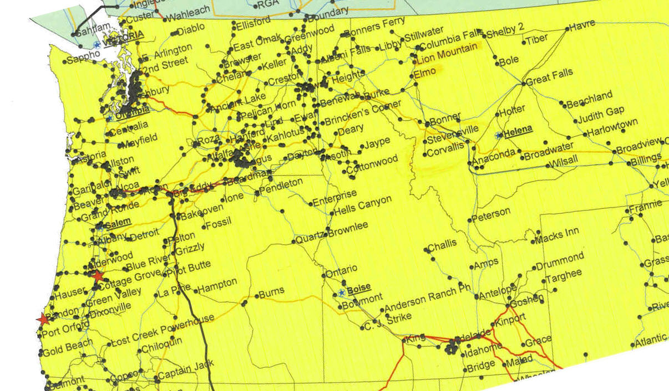
Substations in the PNW
How do we determine power flows in the transmission grid when power can be injected and withdrawn from virtually any of the 4,000 substations in the PNW?

Slide 24
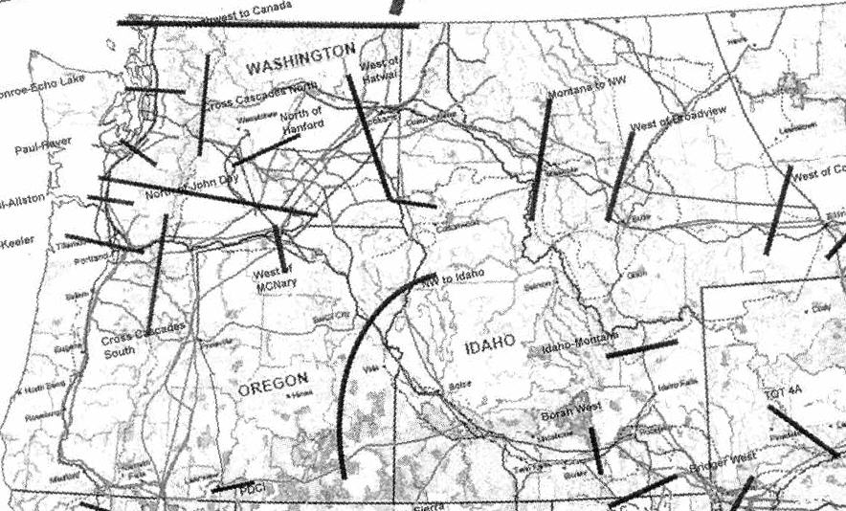
Constraints

Slide 25
Goal: Zones Based on Power Flow
Source: Map substatn match to BPA PDTF names.xlsm

Slide 26
Strategy
Aggregate substations according to the similarity of their “effect” of constraints in the system

Slide 27
Why this needs to be done efficiently: business vs. physics
75 % of power flow lies off the contract path!

Slide 28
Shortcut Power Flow Calculation

Slide 29
Superposition of Linear Systems

Slide 30
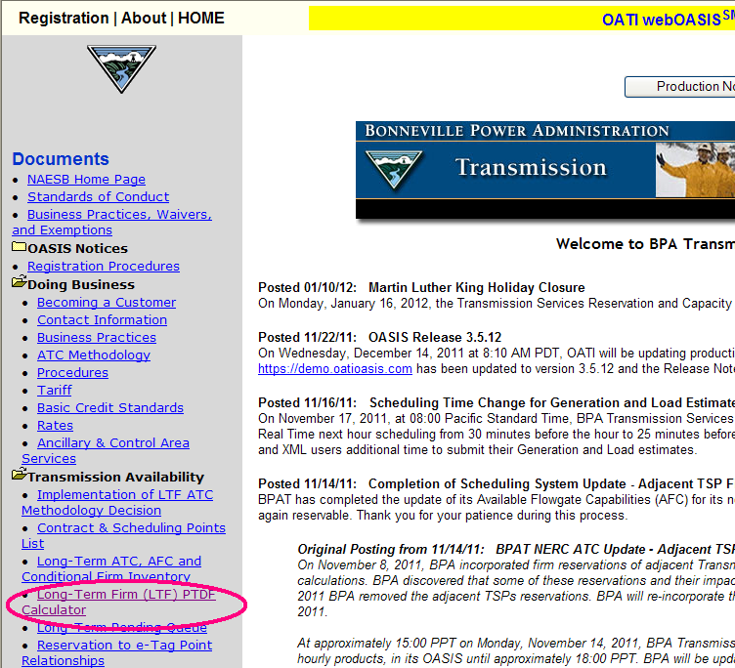
Data Source
BPA provides a power flow estimation tool on its website: http://www.oatioasis.com/bpat/

Slide 31
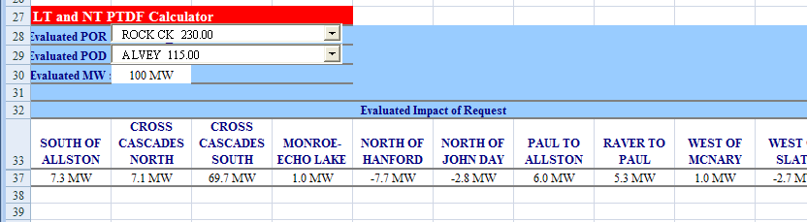
BPA’s Excel-Based Calculator
This calculator estimates the power flow across twelve cut planes, given injections and withdrawals at specific substations.
This is accomplished by using “generation shift factors”, the estimated flow, based on a linear model, to an arbitrary but fixed “reference” substation from each of the other substations.

Slide 32
180 “Generation Shift Factors”

Slide 33
Euclidean Metric
With the Euclidean metric, two sets of shift factors are similar only if the flows are close for all the flow-gates
d(x,y)= (x₁-y₁)²+ (x₂-y₂)²+ … + (x_{k}-y_{k})²

Slide 34
Cutting the Dendrogram
Part of what we are trying to determine is the number of clusters necessary to represent the zones. Neither a single zone or putting each substation in its own zone is very satisfying.

Slide 35
R does the cut
> Transmission_Cluster <-read.table("C:\\BPA.csv", header=TRUE, sep=",")
> XMN <- agnes(Transmission_Cluster, metric="euclidean", stand=TRUE,diss=FALSE)
> XMN_HClust <- as.hclust(XMN)
> cutree(XMN_HClust,k=4:30)
> quit()

Slide 36
Clustering at Various Levels

Slide 37
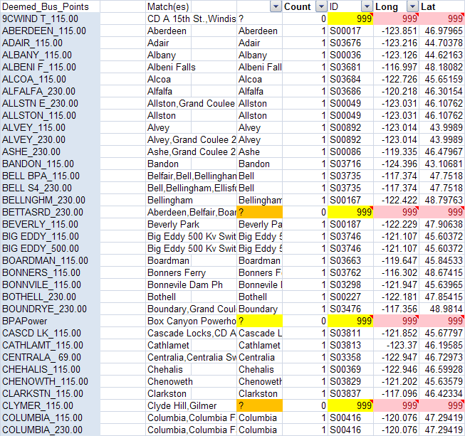
Combine GIS and Clustering
This is perhaps the most subjective part of the analysis
We used simple pattern recognition on the substation names to match the 143 unique BPA substations to GIS names

Slide 38
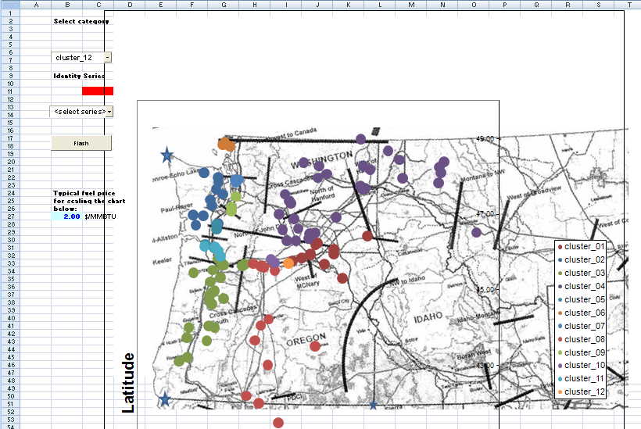
Selecting Clusters with Excel

Slide 39
Preliminary Validation
The above shows the difference using a detailed and simplified (12-cluster representation) calculation of the impact on each cut plane of a 100 MW transfer between Rocky Reach in the Mid-C area and the La Grande substation in eastern Oregon. Directions of flow are consistent, but magnitudes are somewhat muted.

Slide 40
Overview
The NW Power and Conservation Council
Aggregation of power generation resources with cluster analysis
Identifying transmission congestion zones in the PNW
Summary of concepts

Slide 41
Summary
Agnes and other methods are the “Cluster” package
The choice of metric is determined by the question you are asking
“Manhattan” works well for (almost) linear functions of variates
“Euclidean” works well if all variates are equally important
Others exist: Binary, Minkowski, etc.
Plot() on an Agnes object gives you the dendrogram
As.hclust() on an Agnes object and cutree() on a hclust object will produce any number of clusters you need

Slide 42
End

